Slide 1
Ohad Beit-on – VP sales at Sightsys
IAR SYSTEMS
Tel Aviv May 17, 2017

Slide 2










Sightsys
Embedded development tools vendor
USB
File system
TCP/IP
Bluetooth
2
Notes:
IAR has a wide echo system and relationship to different partners.

Slide 3

THE WORLD’S LEADING VENDOR OF EMBEDDED DEVELOPMENT TOOLS
170 Employees HQ in Uppsala, Sweden
Listed in Stockholm/Nasdaq R&D investment 32% of revenue
32 years in the industry
Uppsala Munich Sao Paulo Tokyo Seoul Shanghai London Paris San Francisco Dallas Boston Los Angeles
+Distributor
representation
in 43 countries
Professional technical
support in 12
languages

Slide 4


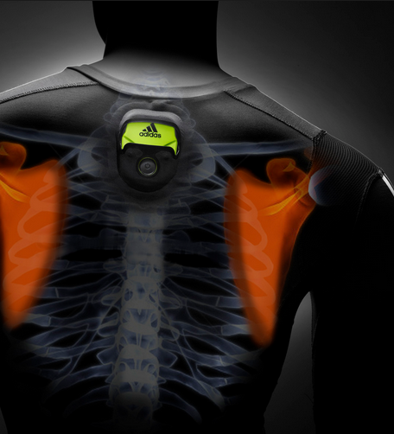








LARGE AND LOYAL CUSTOMER BASE WORLDWIDE
46,000+ customers
95% recurring customers
65% customers with more than one product
22,000+ support agreements ~400 enterprise agreements
200,000+ newsletter subscribers
100,000+ web visitors per month
10,000+ downloads per month
450+ partners in ecosystem
Market Leading
for
www.iar.com

Slide 5
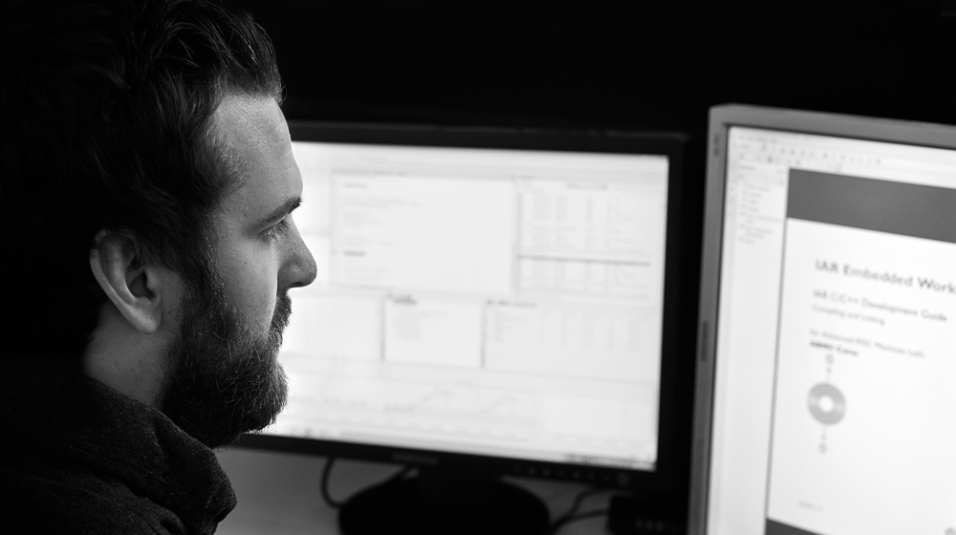
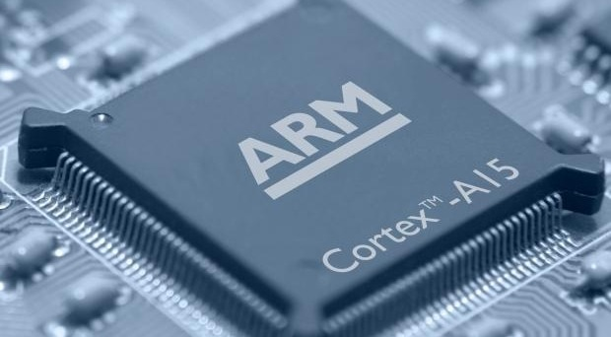

WORLD-LEADING DEVELOPMENT TOOLS
Support for 10 000+ devices, 30+ architectures
All available 8-16-32 bit cores, including all ARM and Renesas MCUs
^{Cortex-A15}
^{Cortex-A9}
^{Cortex-A7}
^{Cortex-A8}
^{Cortex-A5}
^{Cortex-R7}
^{Cortex-R5}
^{Cortex-R4}
^{Cortex-M7}
^{Cortex-M4}
^{Cortex-M3}
^{Cortex-M1}
^{Cortex-M0(+)}
^{ARM11}
^{ARM9}
^{ARM7}
^{SecurCore}
^{XScale}
^{AVR}
^{AVR32}
^{ColdFire}
^{HCS12}
^{S08}
^{MAXQ}
^{CR16C}
^{78K}
^{H8}
^{M16C}
^{R8C}
^{R32C}
^{M32C}
^{RL78}
^{RX}
^{RH850}
^{V850}
^{SuperH}
^{SAM8}
^{STM8}
^{MSP430}
⁸⁰⁵¹
Flexibility and easy migration

Slide 6

DOMINATING THE CORTEX-M MARKET
“Anyone looking at working with a microcontroller based on any of the ARM Cortex-M cores can be sure we are committed to supporting them with high-performance tools, a powerful ecosystem and a passionate support and sales team eager to be of service.” – Stefan Skarin, CEO, IAR Systems
Unbeaten performance records for the highly optimizing IAR C/C++ Compiler for microcontrollers based on the ARM Cortex-M processor family
ARM core | Device | Compiler | CoreMark/MHz
Cortex-M7 | ST STM32F756NGH6 | IAR C/C++ Compiler for ARM | 5.01
Cortex-A9 | Renesas RZ/A1H | IAR C/C++ Compiler for ARM | 4.15
Cortex-M4 | Freescale Kinetis K70 | IAR C/C++ Compiler for ARM | 3.40
Cortex-M3 | Atmel SAM3SD8CAU | IAR C/C++ Compiler for ARM | 3.32
Cortex-M0+ | Atmel SAM D20 | IAR C/C++ Compiler for ARM | 2.46
Cortex-M0 | ST STM32F051C8 | IAR C/C++ Compiler for ARM | 2.20
www.iar.com/armbenchmarks

Slide 7
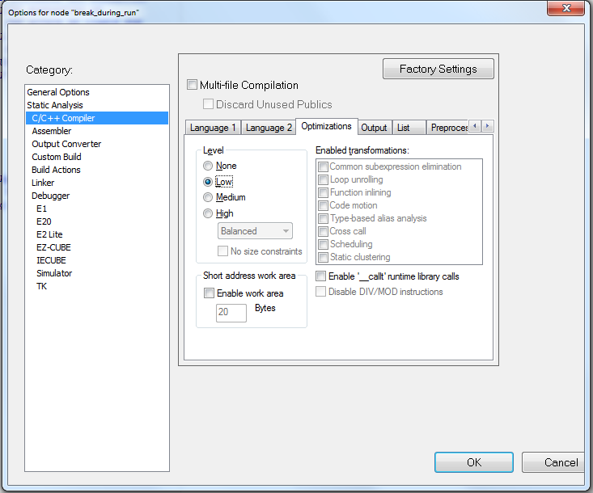
World leader Optimizer
Typically available:
Minimize code size (“size”)
Minimize execution time (“speed”)
Low, Medium, High
Enable individual transformations
Use highest settings!
Settings only approximate
Best guess by compiler writer
Test several settings, check the results
Enable the productive transformations
Notes:
The compiler’s optimizer performs, among other things, dead-code elimination, constant propagation, inlining, common sub-expression elimination, scheduling, and
precision reduction.
It also performs loop optimizations, such as unrolling.
You can choose between several optimization levels, and for the highest level you can
choose between different optimization goals—size, speed, or balanced. Most
optimizations will make the application both smaller and faster. However, when this is
not the case, the compiler uses the selected optimization goal to decide how to perform
the optimization.
By default, a debug project will have a size optimization that is fully debuggable, while a release project will have a high balanced optimization that generates small code without sacrificing speed.

Slide 8

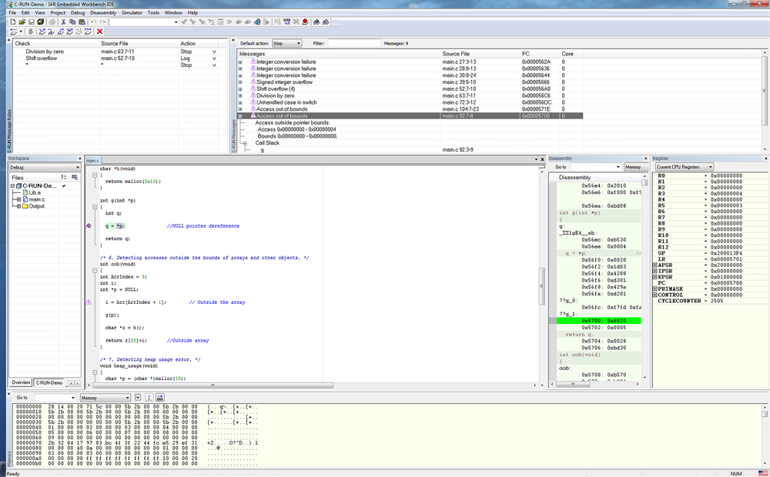
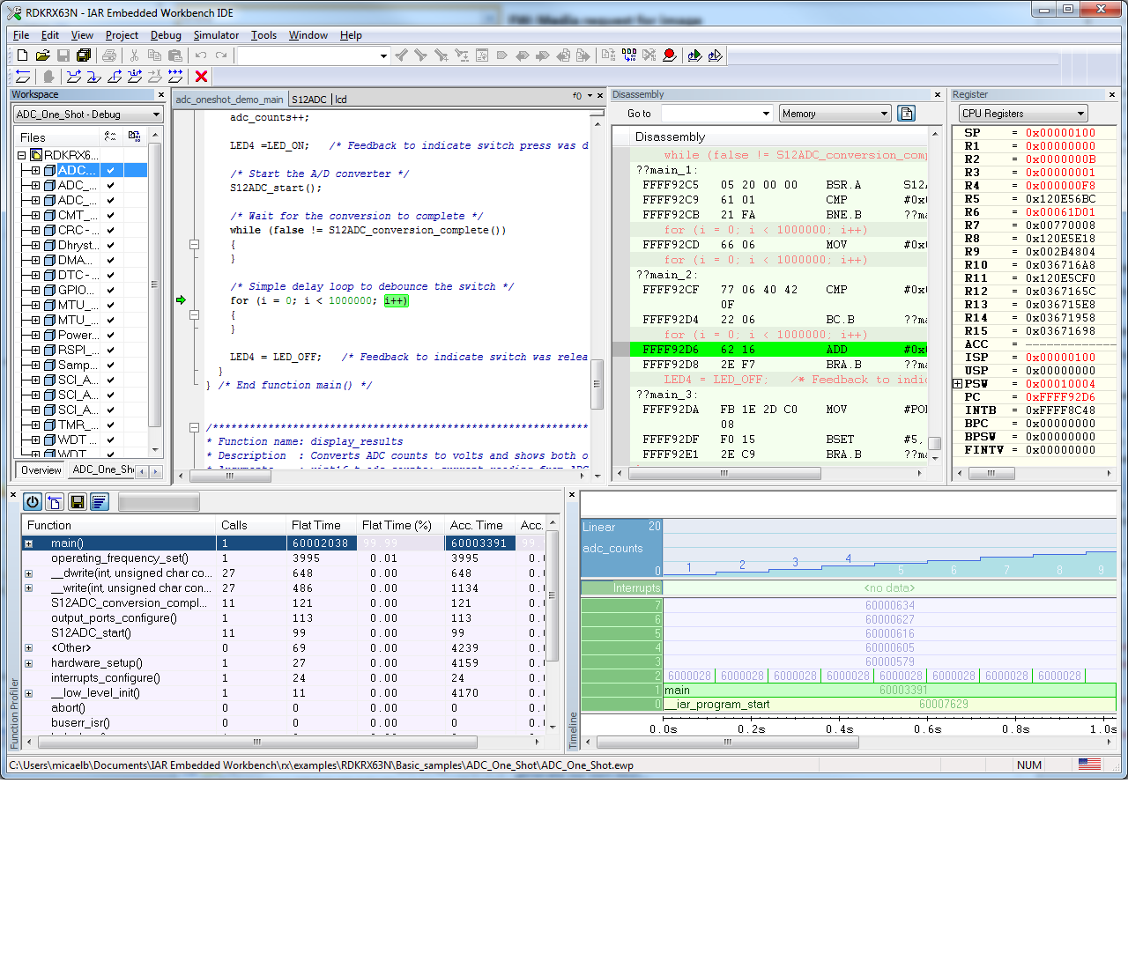


IAR EMBEDDED WORKBENCH – POWERFUL C/C++ COMPILER AND DEBUGGER TOOLCHAIN
Outstanding performance through sophisticated optimization technology
Comprehensive debugger
User-friendly features and broad ecosystem integration
Global support and training
46,000+ active and global customers
95 % recurring customers
65% customers with more than one product
22,000+ support agreements worldwide
200,000+ newsletter subscribers
100,000+ web visitors
10,000+ downloads
200+ partners in ecosystem
330+ enterprise agreements
MISRA-C checker Renesas ABI compliant

Slide 9
IAR EMBEDDED WORKBENCH WITH INTEGRATED ANALYSIS TOOLS
”
We enable developers to take full control of their development and gain efficient, adaptable workflows delivering dependable products.
Maximized performance by compiler experts
Fully integrated
runtime and static analysis
IDE tools
Build tools
IAR C-SPY Debugger
Editor Project manager
Library builder
Librarian
IAR C/C++ Compiler
Assembler
Linker
Simulator driver
Hardware system drivers
Power debugging
RTOS plug-ins
Detailed and flexible static analysis results
Detailed and flexible
runtime error information

Slide 10
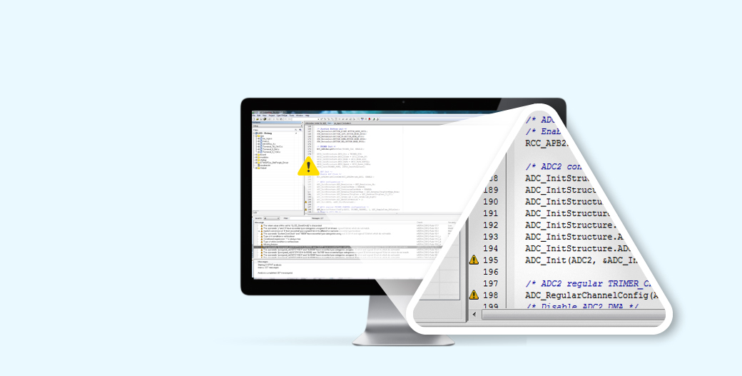
C-STAT STATIC ANALYSIS ADD-ON PRODUCT AVAILABLE FOR ARM, MSP430, RX, AVR AND AVR32
Analysis of C and C++ code
Intuitive and easy-to-use settings with flexible rule selection
Checks compliance with rules as defined by MISRA C:2004, MISRA C++:2008 and MISRA C:2012
Includes ~250 checks mapping to hundreds of issues covered by CWE and CERT C/C++

Slide 11
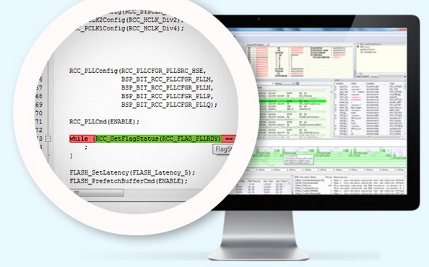
C-RUN RUNTIME ANALYSIS ADD-ON PRODUCT AVAILABLE FOR ARM
Support for C and C++ code
Intuitive and easy-to-use settings
Code correlation and graphical feedback in editor
Bounds checking to ensure accesses to arrays and other objects are within boundaries
Heap and memory leaks checking
Comprehensive and detailed runtime error information

Slide 12
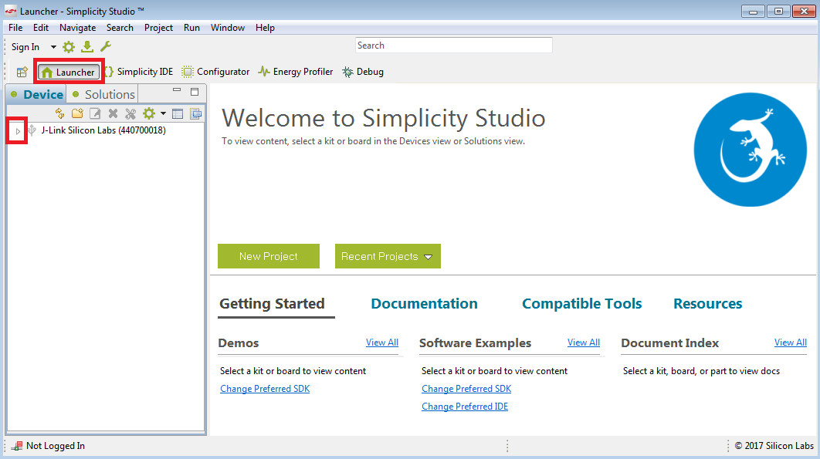
Launcher

Slide 13
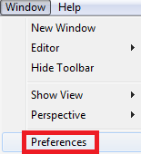
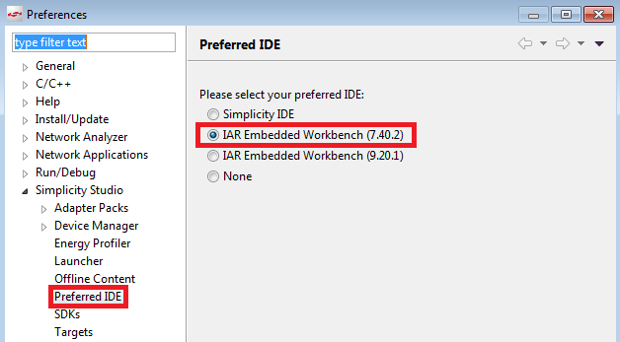
Preferences

Slide 14
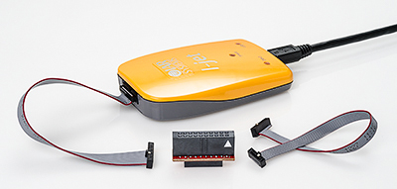
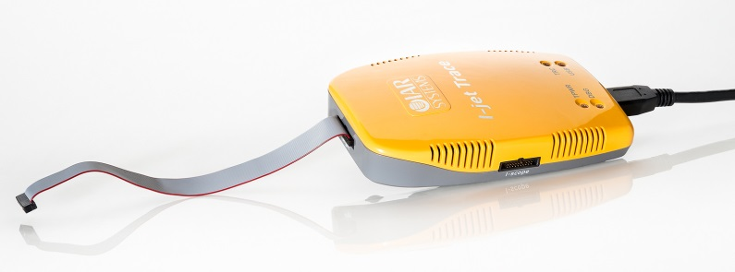
DEBUG PROBES
I-jet for ARM
Support several different
Dedicated drivers, e.g.
J-Link, I-jet.
Trace probes
Different features depending on driver and hardware
I-jet Trace
for Cortex-M
14

Slide 15
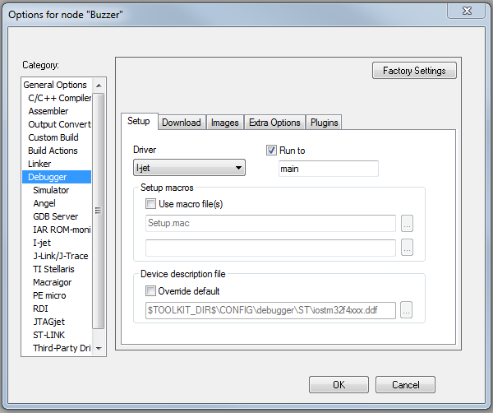
C-SPY OVERVIEW
15
Introduction
Notes:
Before you start C-SPY, you should set options to set up the debugger system. These options are available on the Setup page of the Debugger category, available with the Project>Options command. On the Plugins page you can find options for loading plug-in modules. In addition to the options for setting up the debugger system, you can also set debugger-specific IDE options. These options are available with the Tools>Options command.
Choosing a debug driver
You must also choose a driver for the debugger system from the Driver drop-down list on the Setup page. If you choose a driver for a hardware debugger system, you must also set hardware-specific options.

Slide 16
DEBUGGER FEATURES
Restart Debugger
Step into
Go
Breakpoint
Break
Next statement
Make and Restart Debugger
Reset
Step over
Step out
Stop debugging
Run to cursor
16
Notes:
Basic debugger features.
The name of our debugger is C-SPY

Slide 17
DEBUGGER FEATURES
Disassembly
Memory window
Symbolic Memory window
Register window
Watch window
Locals window
Auto window
Live Watch
Quick Watch
Statics
Call Stack
Terminal I/O
Code Coverage
Profiling
Images window
C-SPY Macros
Stack
Symbols
Code breakpoints
Data breakpoints
Log breakpoints
Trace breakpoints
Data log
Event log
Trace
Power log
Interrupt logging
Multicore
Static analysis
Runtime analysis
17
Notes:
Beside the basic features there are lot of other debugger more advanced features.
How many of these are you or your customers using?

Slide 18
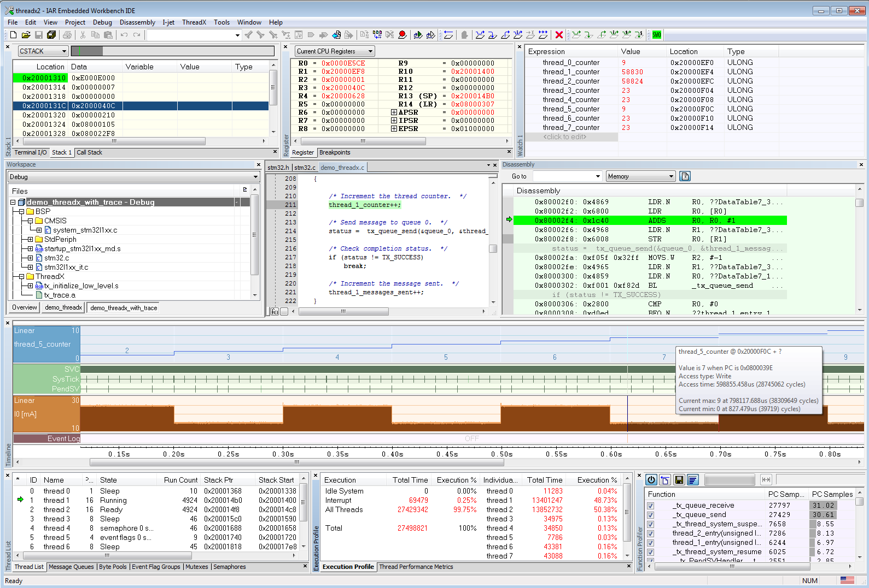
Comprehensive debugger
Broad range of in-circuit debugging probes supported
Trace support
Direct flash erase and download
C like macro system extends debugger capabilities
Built-in simulator driver
Integrated debugger for source and disassembly debugging
Edit source files without leaving the debug session
Stack usage
Dockable windows and tab groups
Power vizualization
Timeline window
RTOS awareness
Performance analysis

Slide 19
BREAKPOINTS

Slide 20
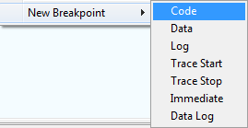
OTHER BREAKPOINTS
There are more than just “normal” code breakpoints:
Data breakpoint Halts the target at access of a specific memory location/range set in memory window, optional with a certain pattern match (dependent on driver)
Log breakpoints
Trace start/stop breakpoints triggers collection of ETM trace data
Immediate breakpoints simulator only, association with C-SPY macros
20
Breakpoints
Notes:
The DWT unit, Data Watch point and Trace Unit, can also halt execution. The debugger sets a watch point. The Unit will halt when a match in data is found.
Data not on stack, an address is required
No performance loss

Slide 21
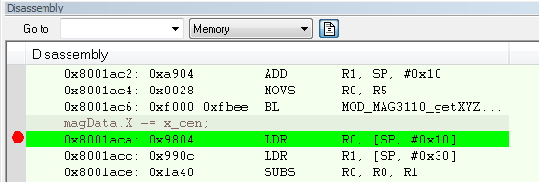
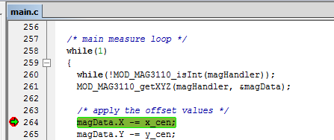
Breakpoints
Toggle breakpoints on any C or assembly line.
Define complex breakpoint conditions.
Data breakpoint
Log breakpoints
Notes:
Toggle breakpoints on any C or assembly line.
Define complex breakpoint conditions.
Data breakpoint - Halts the target at access of a specific memory location, optional with a certain pattern match
Log breakpoints

Slide 22
HARDWARE & SOFTWARE BREAKPOINTS
On a Cortex M device the debugger (C-SPY) instructs the ”Flash Patch and Breakpoint Unit“ to halt the core on a specific instruction
Limit in number of breakpoints
Software breakpoints
Here the debugger replaces the instruction where we want the breakpoint with a bkpt instruction. After stopping the instruction is inserted again.
Require the ability to program the memory where the code is placed.
 | ARM7 | ARM9 | CM0 | CM0+ | CM3 | CM4 | CM7 | CR4
Breakpoints | 2 | 2 | ≤ 4 | 6 | 6 | 6 | 8 | 4
Watchpoints (DWT) |  |  | ≤ 2 | 4 | 4 | 4 | 4 | 8
22
Breakpoints

Slide 23
SERIAL WIRE DEBUG
-SWD

Slide 24
SWD, THE MODERN JTAG REPLACEMENT
JTAG was originally intended as a test interface
Each device implement its Test Access Port
Four pins, inefficiently used
640Kbytes/sec per data pin at 20MHz
SWD is a debug interface
Two pins
1600 Kbytes/sec at 20MHz with a single data pin
8 pin packages M0 devices
Small design
2500 gates additionally
NEW POSSIBILITIES
24
SWD

Slide 25
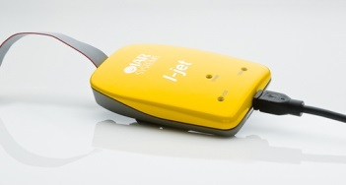
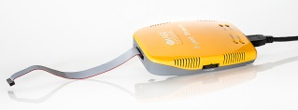
ARM CORESIGHT OVERVIEW
FPB
DAP
DWT
6 breakpoints
Live
core access
4 watchpoints
PC sampler
ITM
JTAG
ETM trigger
Software trace
32 channels
SWD/SWO
I-jet
Interrupt trace
Time stamping
Trace port
CPU statistics
ETB
ITM Instrumentation Trace
instruction trace
ETM Embedded Trace Macrocell
ETM
instruction trace
ETB Embedded Trace Buffer
25
SWD

Slide 26
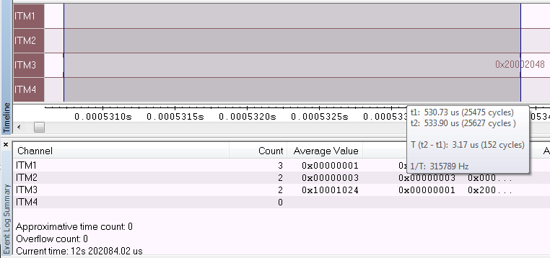
ITM EVENTS
More modern feature is the ITM events.
In your code include ITM_EVENT(channel, value)
ITM_EVENT8(3, 0);
Timer2Init();
ITM_EVENT32(3,__get_SP() );
0x00
Notes:
Simple way of sending small packets of data
Tracking data
PC
Tasks
Measuring time in and out of functions
ITM_EVENT(channel, value)
During debugging, open the timeline window to display the data
Optional module for Cortex-M3/M4
Low-speed/sampled trace
ITM packets are triggered by e.g. interrupts, read/write accesses to variables or actively sending ITM events
SWO (single wire output) is a serial high speed signal that transmits ITM packets
Works with standard debug interface and in-circuit debugging probe (e.g. IAR Systems‘ I-jet)

Slide 27
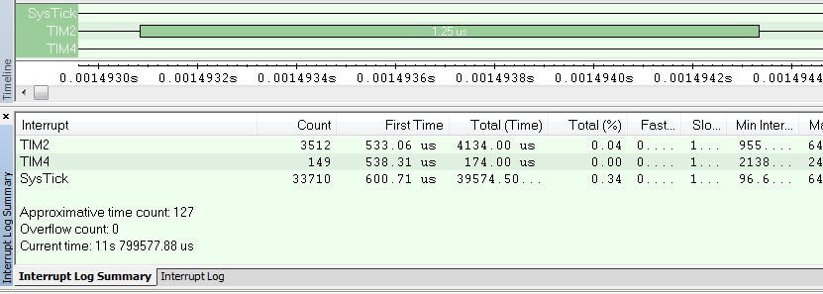
INTERRUPT LOGGING
Everytime an interrupt enters or exits, a timestamp is sent to C-SPY.
Great for verifying timing of interrupts
Verify how interrupts are interrupted by others with higher priority.
27
Notes:
Similar as ITM event but for interrupts

Slide 28
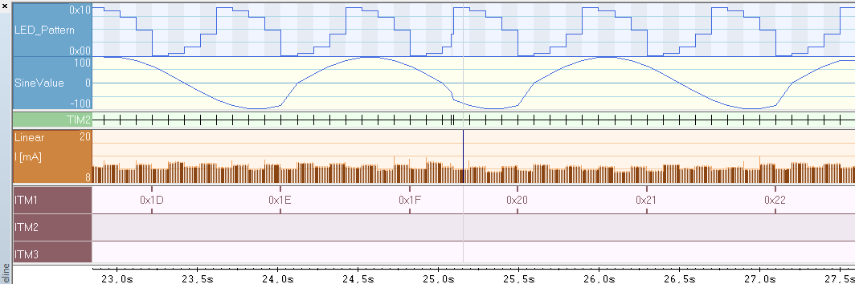
EXAMPLE
Interrupt log
Data log
Power debugging
ITM event with line graph
ITM_EVENT8(channel_1, my_counter);

Slide 29
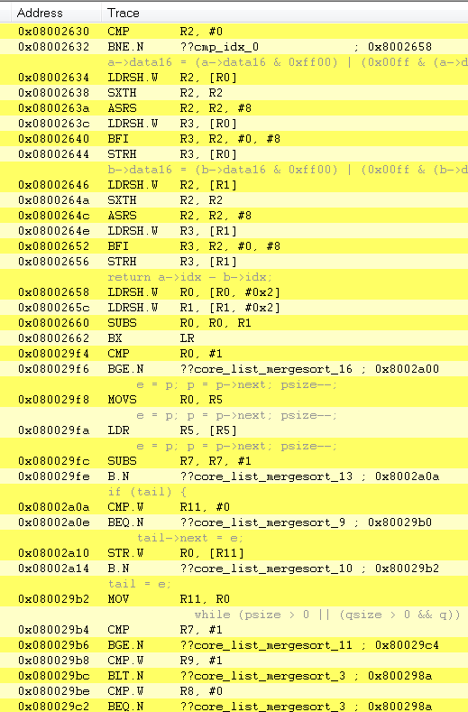
TRACE
Follow the program flow
Tells where the application has been and how you got there
Go back in time and evaluate execution backwards
29
Notes:
By using trace, you can inspect the program flow up to a specific state, for instance an
application crash, and use the trace data to locate the origin of the problem. Trace data
can be useful for locating programming errors that have irregular symptoms and occur
sporadically.

Slide 30
TRACE
Without trace: Usually not that much information available
With trace: Possible to go back in time and evaluate the behavior
Bug
happens
Break
Time
Without trace
Trace information
With trace
~10^{3..} ~10⁶ instructions
30
Trace

Slide 31
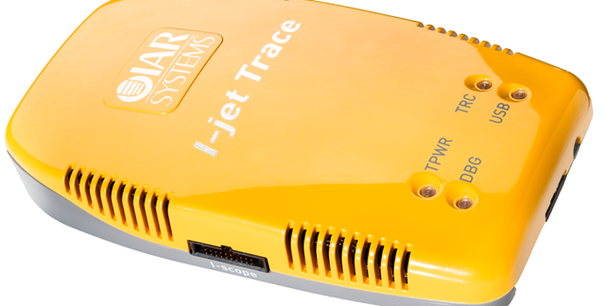
ETM INSTRUCTION TRACE
Each executed instruction is recorded
Normally by sending info to dedicated pins on device
Require special HW to receive
Trace probe
Large amounts of data
Limited memory
trace port
ETM Embedded Trace Macrocell
ETM
instruction trace
31
Trace
Notes:
Fast signals → high requirements on board design
Data stored in the trace buffer on the probe

Slide 32
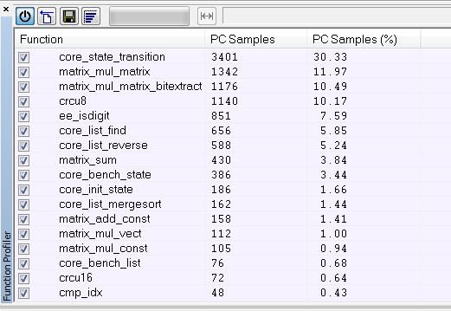
FUNCTIONAL PROFILING
Using trace data
Where is the most time spent?
Focus on those functions when optimizing the code
32
Notes:
Using trace data, the tools can describe where in the code the time is spent. This is called function profiling.

Slide 33
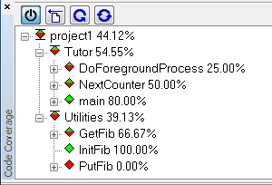
CODE COVERAGE
Verify whether all parts have been executed
Using trace data
Possible to require that all code is really tested, i.e. executed in a test session
33
Notes:
Is all code tested according to a standard? Code coverage can help you with that.

Slide 34
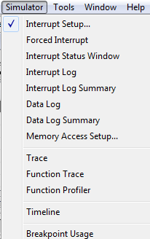
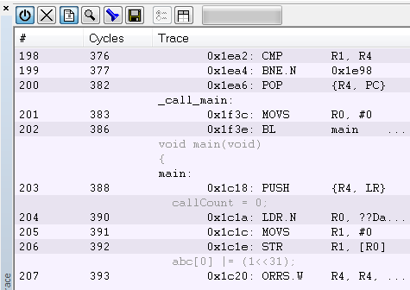
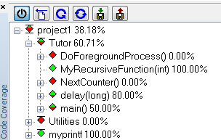
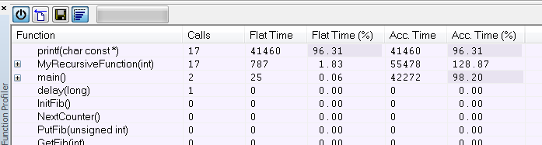
SIMULATOR
In contrast to the debugger with bandwidth-limited communication interface, the simulator does not miss anything and is capable of showing:
Complete (Function) trace
Profiling
Code coverage
34
Notes:
If the hardware doesn’t support a specific feature you can always use the simulator.
Maybe not 100% accurate but it’s better than nothing.

Slide 35

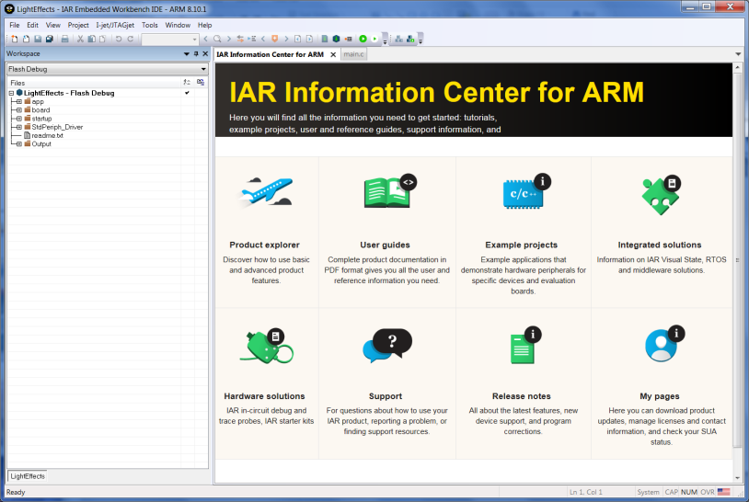
8.10 - Updated IDE look and feel
New EW logo
Better window management and docking
Revised Information Center
Updated tutorials

Slide 36
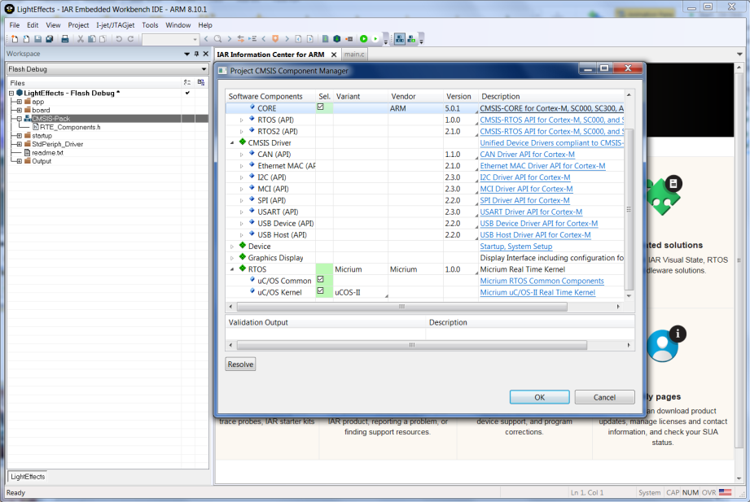
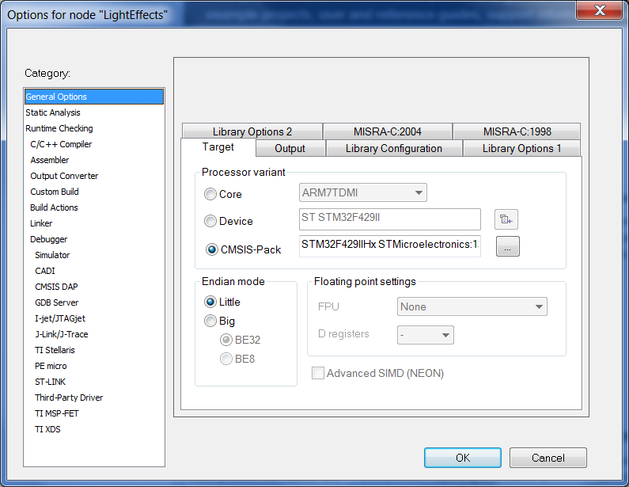
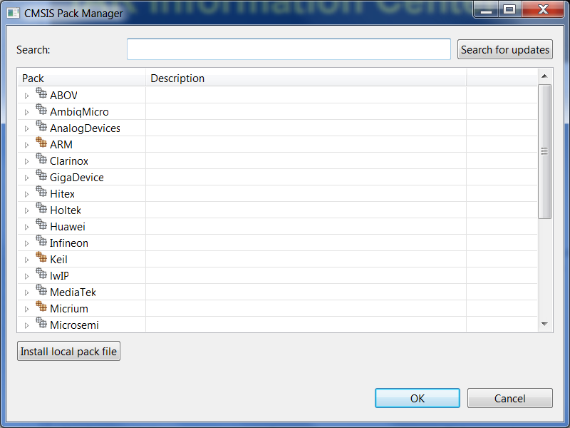
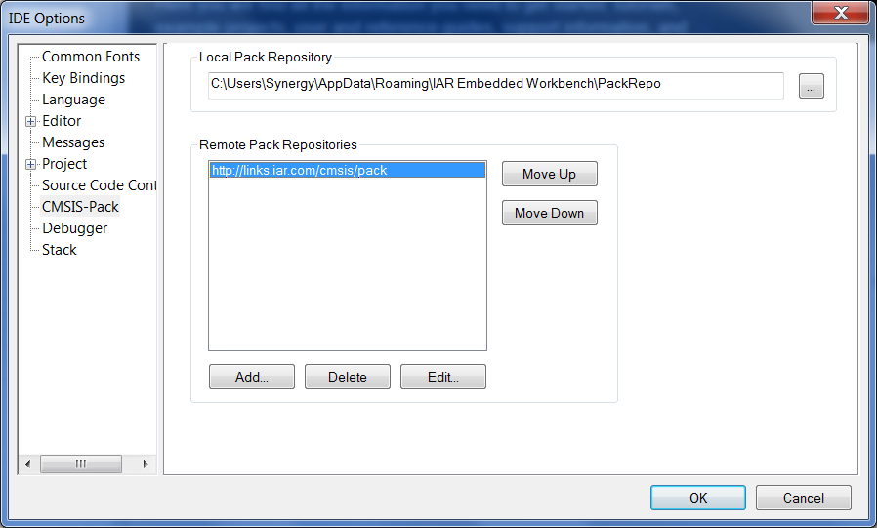
CMSIS-Pack support
Work with ARM CMSIS-Pack software components.

Slide 37
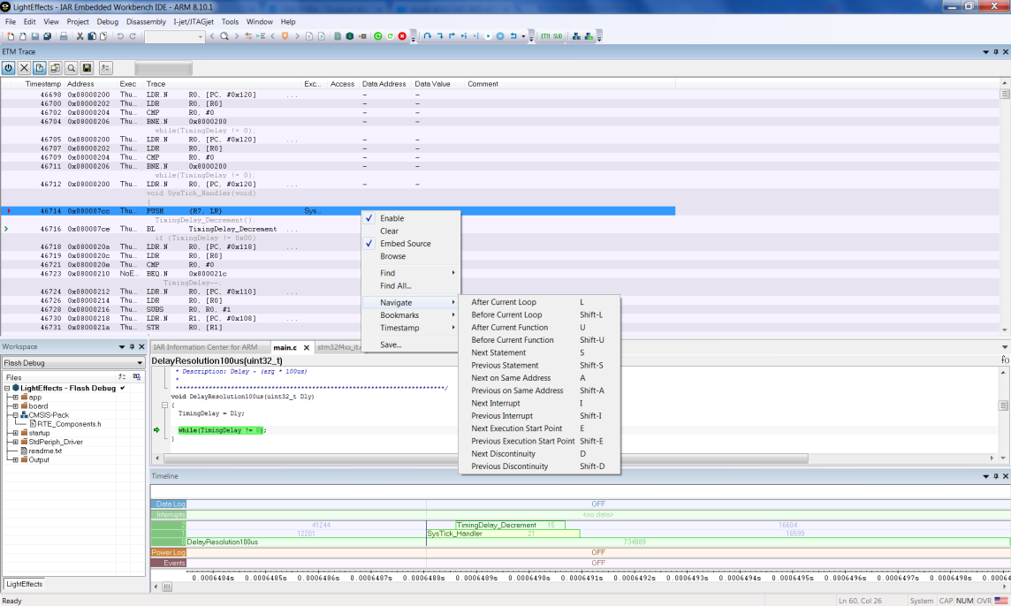
Trace filtering and navigation
Navigate forward/backward
on loop
function
interrupts
statement boundaries

Slide 38
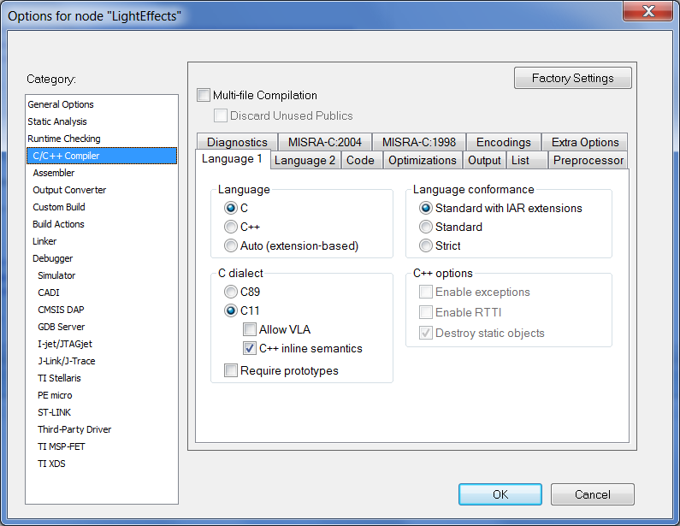
C11 and C++14 language standard support
C language standard ISO/IEC 9899:2011
Multi threading
Anonymous structs and unions
Memory Alignment Control
The _Noreturn Function Specifier
Static Assertions
C++ standard ISO/IEC 14882:2014
Multi threading
Range based for-loops
New binary constants

Slide 39
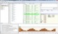
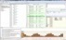
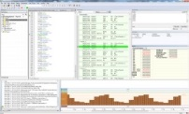

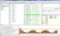
PRODUCT PACKAGES AND LICENSE TYPES
Product packages: | License types:
Full ARM Cortex-M Functional Safety C-RUN | Stand alone | Mobile | Network | Global
Usage | Locked to one PC | USB dongle | One site | Multiple sites
Used by | Single developer | Single developer, multiple computers | Local teams | Global teams

Slide 40
PRODUCT PACKAGES AND LICENSE TYPES
Function/Package | Functional Safety | Standard | Cortex M | Cortex-M0 | Limited | BaseLine
Editor | ✔ | ✔ | ✔ | ✔ | ✔ | ✔
Project Manager | ✔ | ✔ | ✔ | ✔ | ✔ | ✔
IAR C/C++ Compiler for ARM | ✔ | ✔ | ✔1 | ✔2 | ✔ | ✔3
IAR Assembler for ARM | ✔ | ✔ | ✔ | ✔ | ✔ | ✔
Linker and librarian | ✔ | ✔ | ✔ | ✔ | ✔ | ✔
MISRA C checker | ✔ | ✔ | ✔ | ✔
C-SPY® Debugger | ✔ | ✔ | ✔ | ✔ |  | ✔
Run-time libraries incl source code | ✔ | ✔ | ✔ | ✔ | ✔ | ✔
Power debugging | ✔ | ✔ | ✔
Hardware debugging support | ✔ | ✔ | ✔ | ✔ |  | ✔
RTOS plugins | ✔ | ✔ | ✔ | ✔ |  | ✔
Support and Update Agreement (SUA) | ✔ | ✔ | ✔ | ✔ | ✔ | Limited4
Static code analysis |  | Optional5 | Optional5 | Optional5
Runtime analysis |  | Optional6 | Optional6 | Optional6
Certified for Functional Safe | ✔

Slide 41




Thank you for attention!

